Slide 1

Weekly Progress
GE1.02 Shang-Wei Chang
2025/11/15

Slide 2
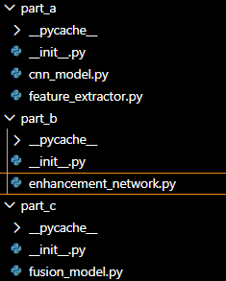
Part A
  cnn_model (for eye tracking)
  Feature_extractor
    Mtcnn lacks details(thus less robust)
      Going back to mediapipe (for now)
    Rppg extraction
      Selectable
        Chrom
        POS method
    Eye drowsiness test (backup)
Part B
  Enhancement_network
    Fundamental structure rework
    Data length alignment
    Training script creation for Enhancment_network(need training)
      Issue encounter, need server to run Vicomtech DMD
Part C
  Fusion_model

Slide 3
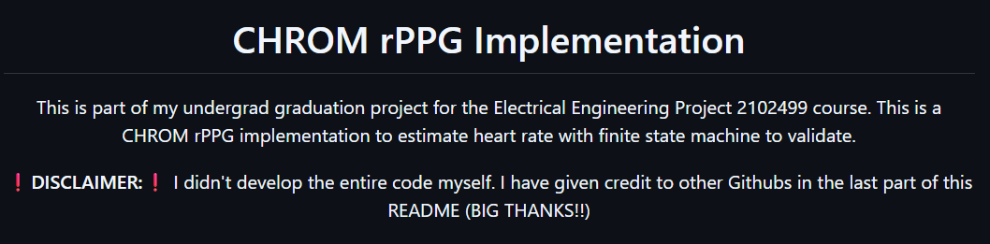
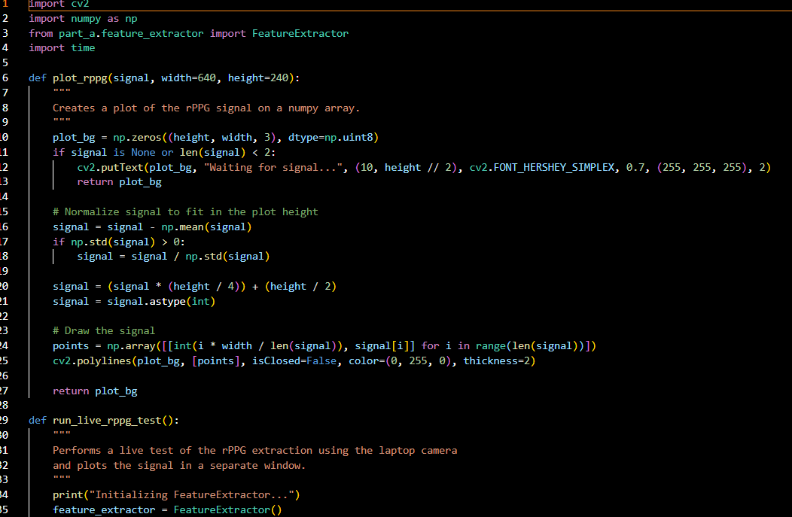
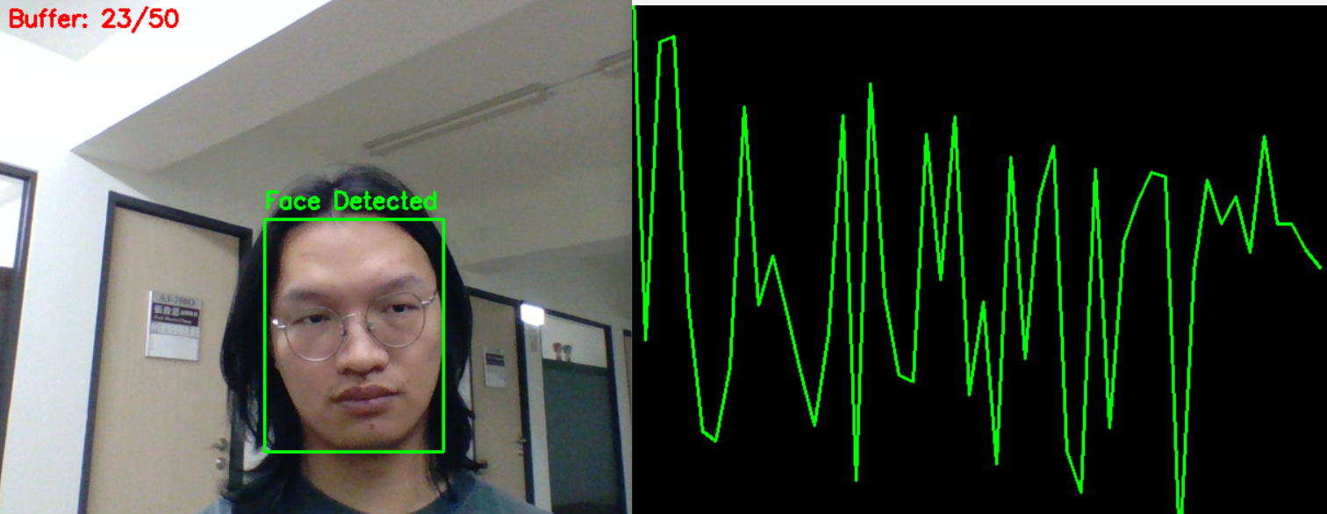
For rppg extraction I mainly uses Chrom rPPG. I had created a test program and run.
This is last week.

Slide 4
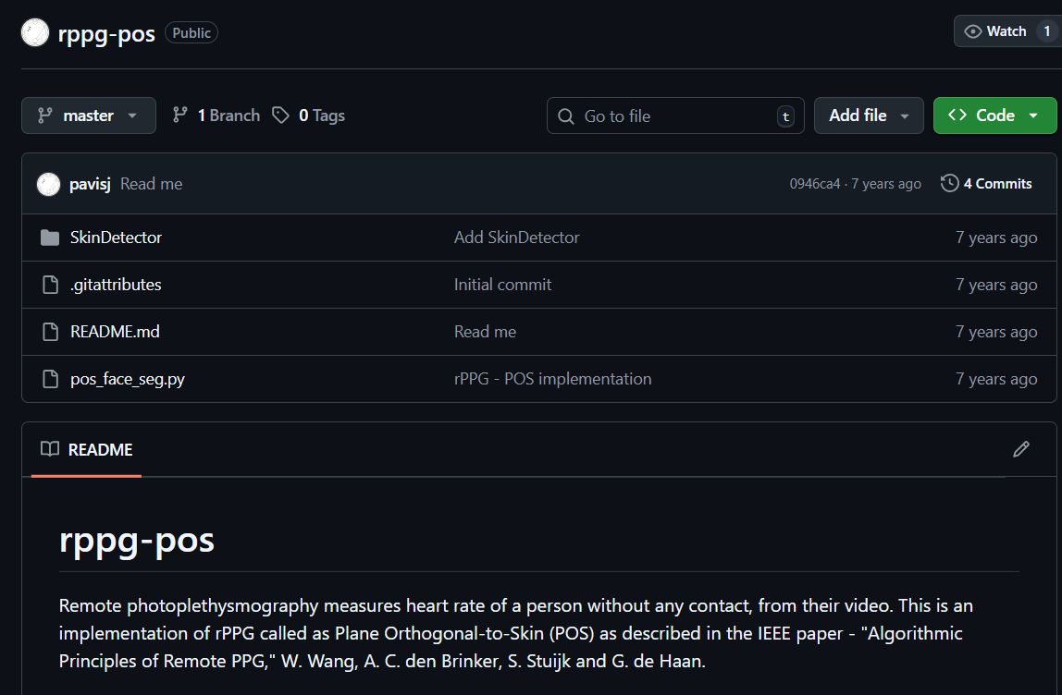
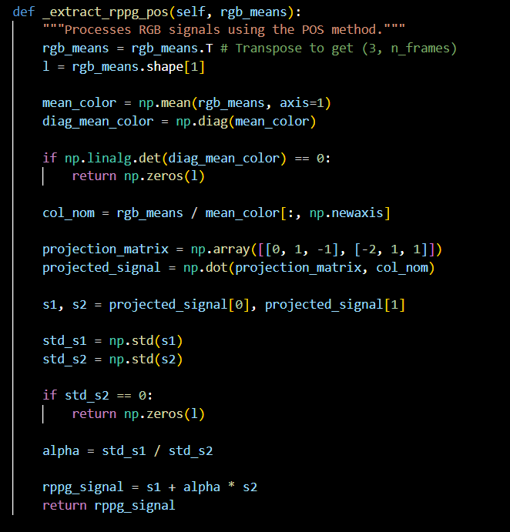

Slide 5
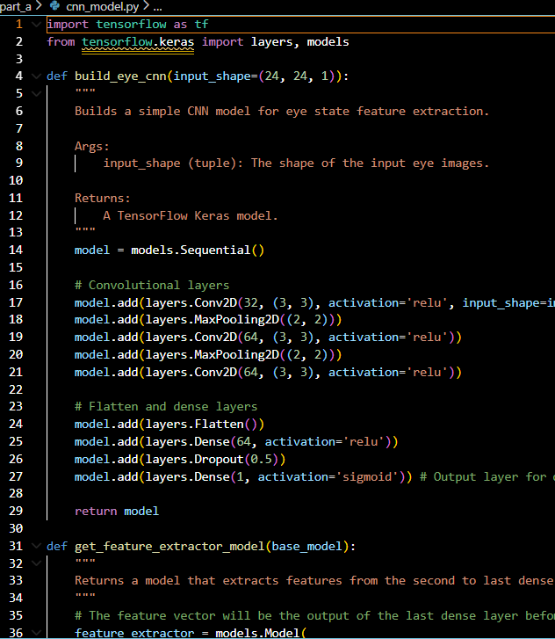
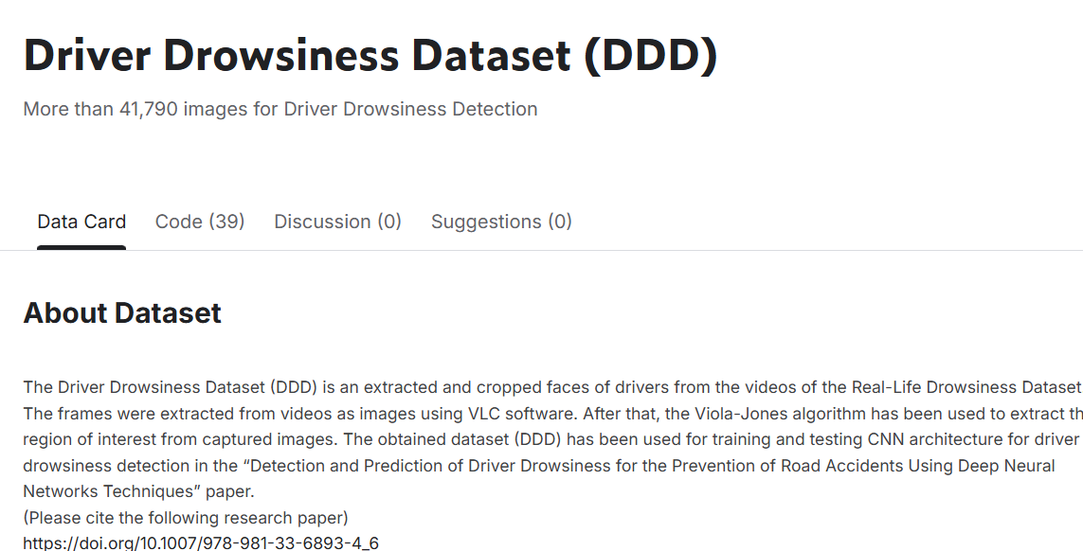
Last week using eye_CNN
Data alignment issue
Model lacks detail comparing to the original MTCNN in the paper
  Not open source
  Tried Haar-cascade+SLIC superpixel, but it’s not better than mediapipe

Slide 6
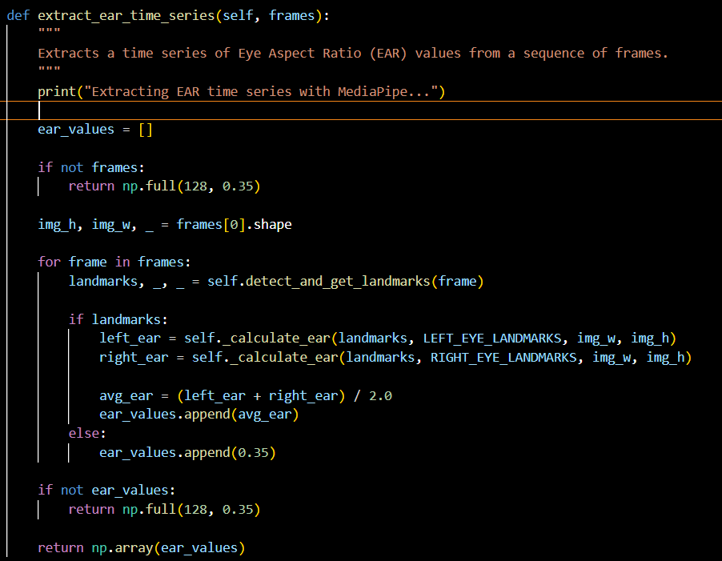
Updated EAR values using MediaPipe
Replacement update
Need testing from enhancement model portion

Slide 7
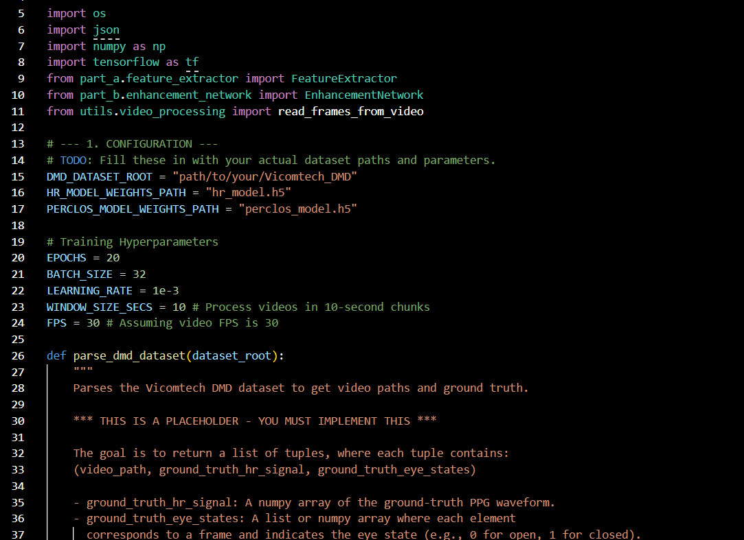
Training script for enhancement model
Part B
  Enhancement_network
    Fundamental structure rework
    Data length alignment
    Training script dev. for Enhancment_network(need training)
      Issue encounter, need server to run Vicomtech DMD
Input (from partA feature extractor)
  1D CNN rppg signal for HR
  1D from PERCLOS
Output
  HR value
  PERCLOS value

Slide 8
Thank you for listening
Q&A session

